Slide 1

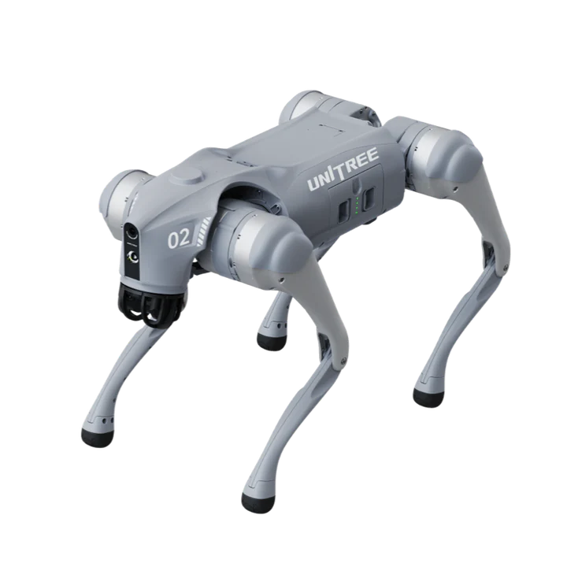

Unitree GO2 Pro Robot how to bring to EDU level
&
Name - 1) Shailesh Shinde
2) Amit Sable
iTech Robotics & Automation Pvt.Ltd Pune

Slide 2
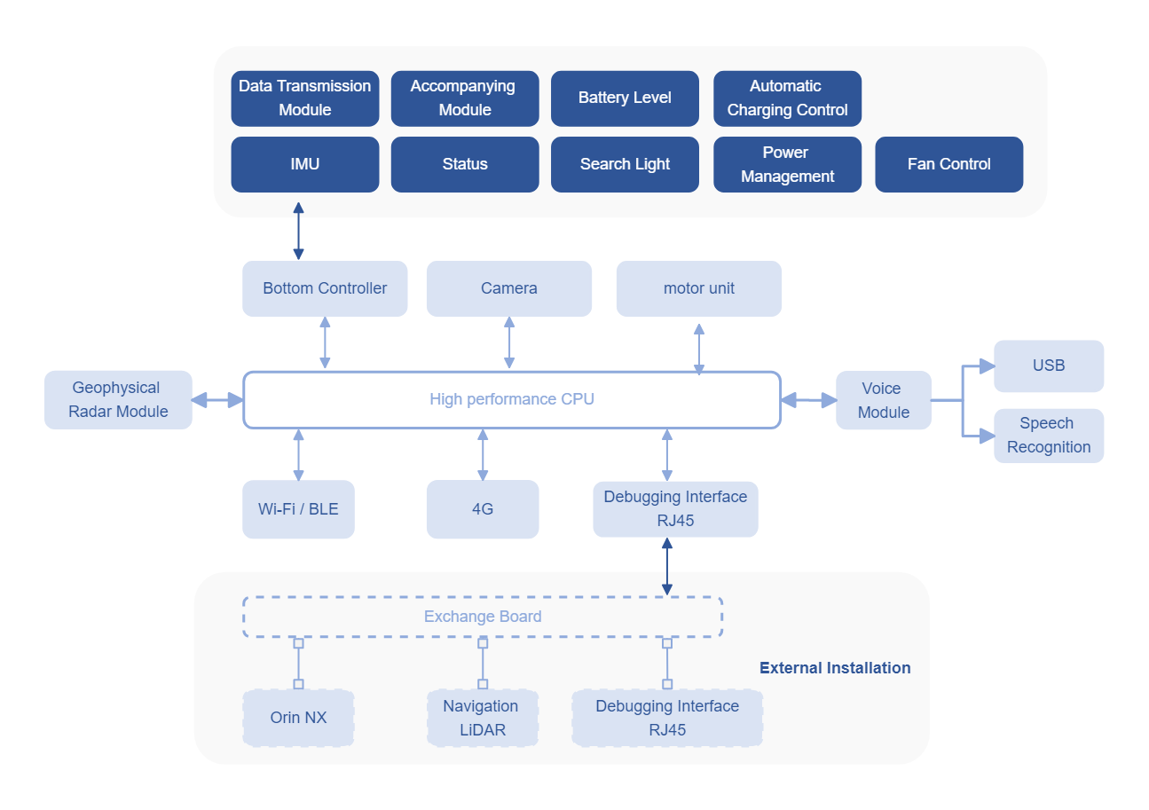
Hardware architecture
https://wiki.theroboverse.com/en/firmware/secondary_development
iTech Robotics & Automation Pvt.Ltd Pune

Slide 3
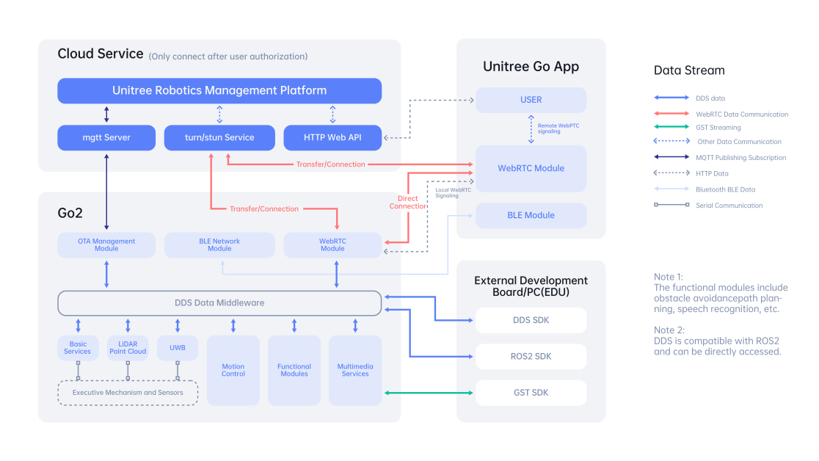
Software architecture
https://wiki.theroboverse.com/en/firmware/secondary_development
iTech Robotics & Automation Pvt.Ltd Pune

Slide 4
SDK Development Guide
Follow the instructions in the guide to set up your development environment, configure parameters, and understand the SDK functionalities specific to the PRO model
Utilize the resources and references in the guide to create your own applications tailored to the capabilities of the PRO model.
Ensure to adhere to any restrictions or limitations mentioned for the PRO model in terms of customization and programming.
The PRO model may have restrictions compared to the EDU version, by following the Motor SDK Development Guide and leveraging the available resources, you can still develop applications and integrations for the PRO model of the Unitree humanoid robot.
Motor SDK Development Guide from the provided file_path: https://support.unitree.com/home/en/Motor_SDK_Dev_Guide/Development_Guide
All firmware and data link - https://disk.yandex.com/d/YOEhWFYUKNpezA
https://github.com/abizovnuralem/go2_ros2_sdk
iTech Robotics & Automation Pvt.Ltd Pune

Slide 5
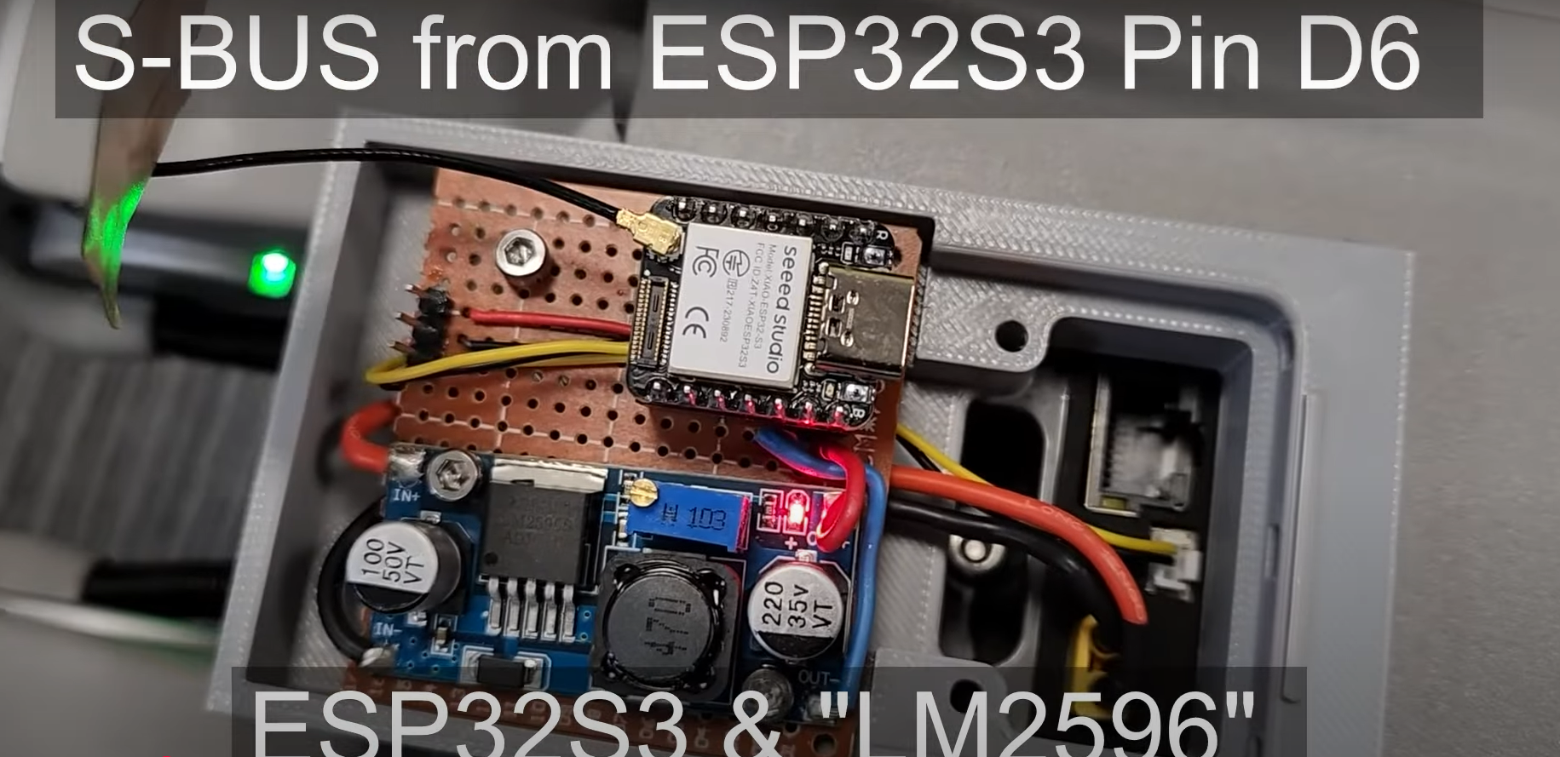
Unitree Go2 control via SBUS with an ESP32
SBUS is a bus protocol for receivers to send commands to servos. Unlike PWM, SBUS uses a bus architecture where a single serial line can be connected with up to 16 servos with each receiving a unique command.
Allows transmission of up to 16 servo channels + 2 digital channels over a single port.
Video Link- https://www.youtube.com/watch?v=AR2y-QA6O1I
iTech Robotics & Automation Pvt.Ltd Pune

Slide 6
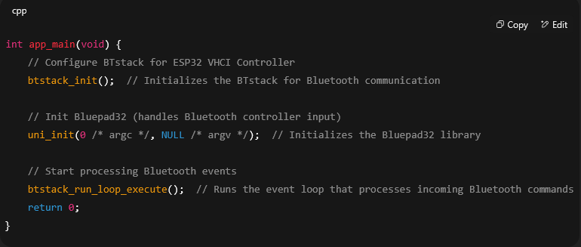
Unitree Go2 control via SBUS with an ESP32
1. Reading Controller Input via Bluetooth:
The movement data from the Bluetooth controller is received. This input is typically joystick movement or button presses that will be mapped to control the servos or motors of the system.
The code for this is found in the initialization of the Bluetooth stack and the Bluepad32 setup
https://github.com/mechzrobotics/Unitree_GO2_SBUS
iTech Robotics & Automation Pvt.Ltd Pune

Slide 7
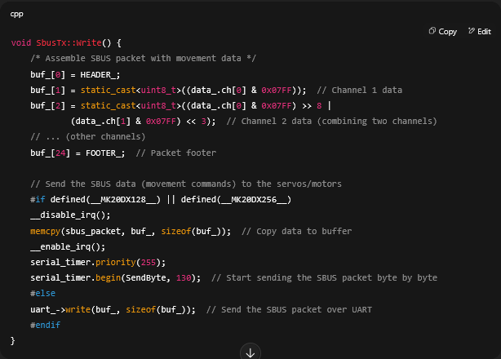
Unitree Go2 control via SBUS with an ESP32
2. Converting Controller Data to SBUS:
The input from the Bluetooth controller (likely joystick movements or button presses) is then mapped to SBUS channels (the channels typically represent motor/servo control). This is where the movement control actually happens.
In the code, this is done in the SbusTx::Write() method
https://github.com/mechzrobotics/Unitree_GO2_SBUS
iTech Robotics & Automation Pvt.Ltd Pune

Slide 8

Unitree Go2 control via SBUS with an ESP32
Movement Control in Code:
Bluetooth Controller Input:
Joystick movements or button presses are received by the ESP32 via BTstack and Bluepad32.
Map Input to SBUS Channels:
The controller's input (joystick values) is mapped to SBUS channels (e.g., data_.ch[0] for the X-axis joystick movement).
Assemble SBUS Packet:
The movement data (SBUS channels) is packed into an SBUS frame using the SbusTx::Write() function.
Transmit SBUS Data:
The SBUS packet is transmitted over UART to control the servos or motors.
3. Movement Control Through SBUS Data:
https://github.com/mechzrobotics/Unitree_GO2_SBUS
iTech Robotics & Automation Pvt.Ltd Pune

Slide 9
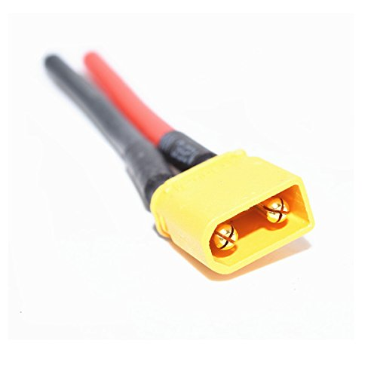
GO2 External Power supply for extended working without battery
Remove battery.
Connect the cable to port XT30U-F BAT INPUT.
Min requirement 30V 20A.
Also check the XT30 male pin connection.
1) Powertron Thane 2) https://idealplusing.en.made-in-china.com/product/tmeYqcEVhvWs/China-Factory-Production-40V-100A-DC-Power-Supply-for-Test-with-Multiple-Protection-Functions-Can-Customize-Analog-Control.html
iTech Robotics & Automation Pvt.Ltd Pune

Slide 10
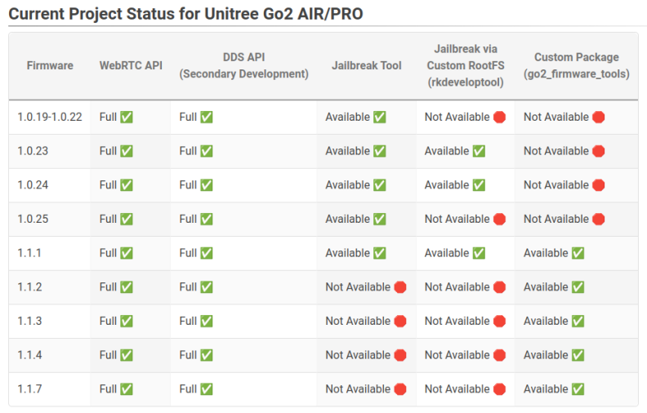
Jailbreaking LLM-Controlled Robots
All firmware and data link - https://disk.yandex.com/d/YOEhWFYUKNpezA
iTech Robotics & Automation Pvt.Ltd Pune

Slide 11
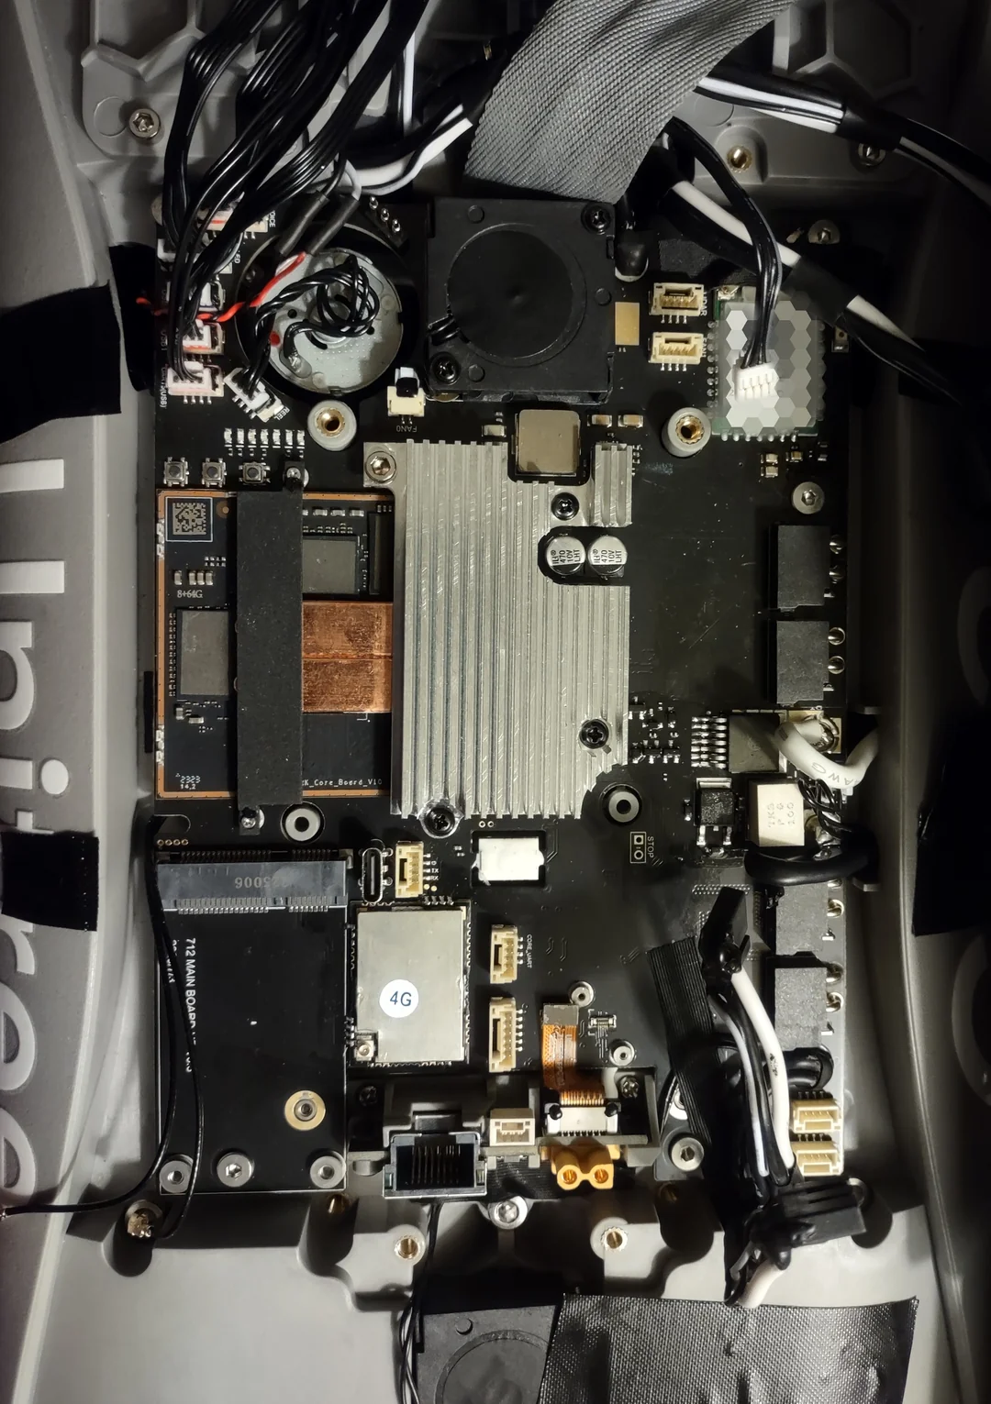
PCIe Gen4 NVMe 2230 M.2 SSD
iTech Robotics & Automation Pvt.Ltd Pune

Slide 12
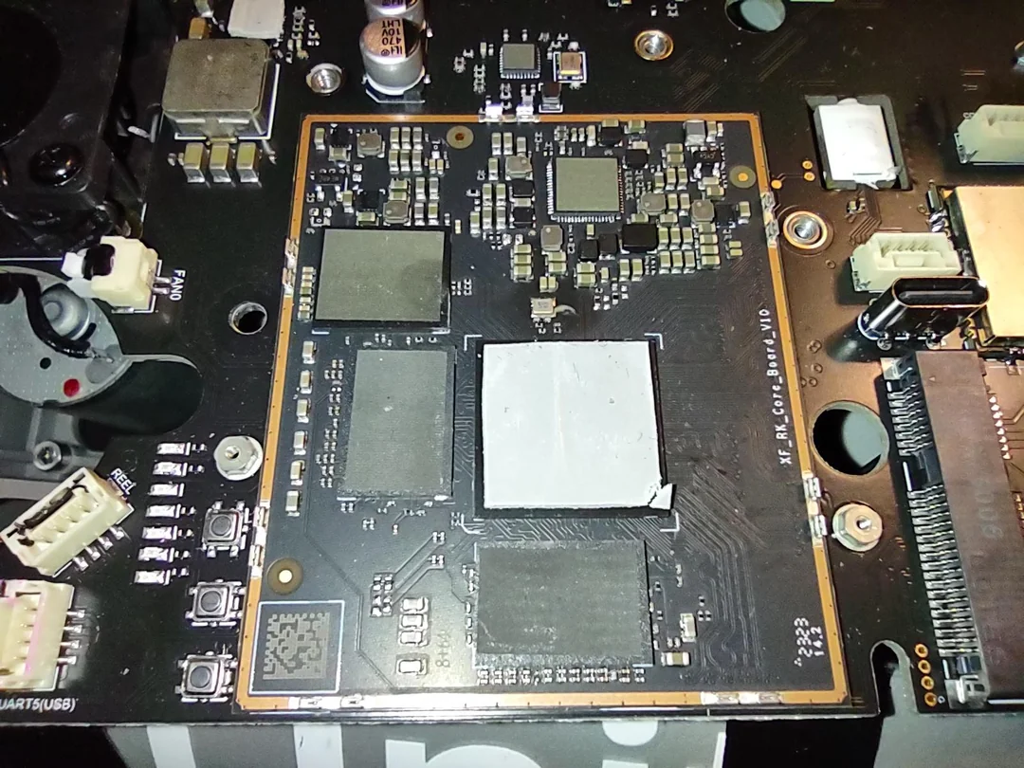
Type C connectivity
Type-C Firmware upgrade: Upgrade port (bottom GH1.25 4Pin) File transfer: Type-C/USB-A Mobile network: SIM card slot External storage: TF card slot/USB-A Tripod fixed: 1/4 threaded hole
iTech Robotics & Automation Pvt.Ltd Pune

Slide 13
Thank You
iTech Robotics & Automation Pvt.Ltd Pune

